Slide 1
Learn Whats New in Tableau 9.0
View Data Visualization with Tableau course details at www.edureka.co/data-visualization-with-tableau
For Queries:
Post on Twitter @edurekaIN: #askEdureka
Post on Facebook /edurekaIN
For more details please contact us:
US : 1800 275 9730 (toll free)
INDIA : +91 88808 62004
Email Us : webinars@edureka.co

Slide 2
Objectives
At the end of this session, you will be able to understand:
How to make Direct connection with Statistical packages
How to Split data columns in Tableau 9.0
All new Tableau Discover Side Menu
How to Connect to Data Source
Dynamically Fast Tool Tip in Tableau 9.0
Data Interpretation in Tableau 9.0
Radial & Lasso Selection Tableau 9.0

Slide 3
Connecting With Statistical Packages
The new connector in Tableau 9.x brings native support for a number of statistical package files including:
.sas7bdat – the file format used by SAS
.sav – the binary file format used by SPSS
.rdata, .rda – the file formats employed by the R statistical analysis package

Slide 4
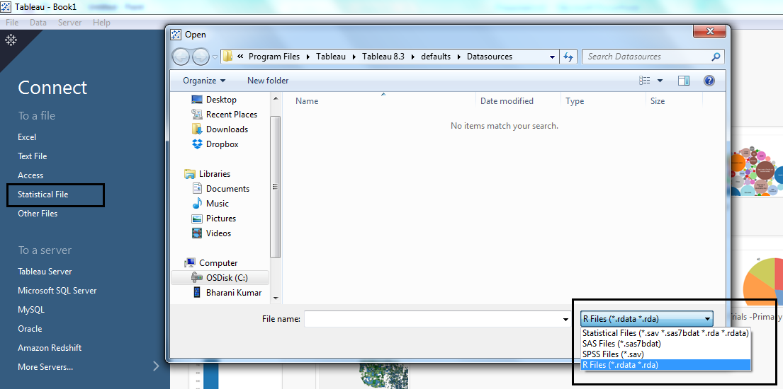
Connecting With Statistical Packages

Slide 5
Splitting Data Columns
If you have string fields in your data that contain multiple units of information, it might be easier to analyze the data if you split the values in that field into separate fields.
For example, the first and last name of a customer
You can use split or custom split options in Tableau to separate the values based on a separator or a repeated pattern of values present in each row of the field.
Just right-click on the dimension you want to split, navigate to the new ‘Transform’ menu and click Split.
Tableau will automatically try to figure out the delimiter and split the data accordingly, but you can also choose Custom Split and specify the delimiter yourself if you like.

Slide 6
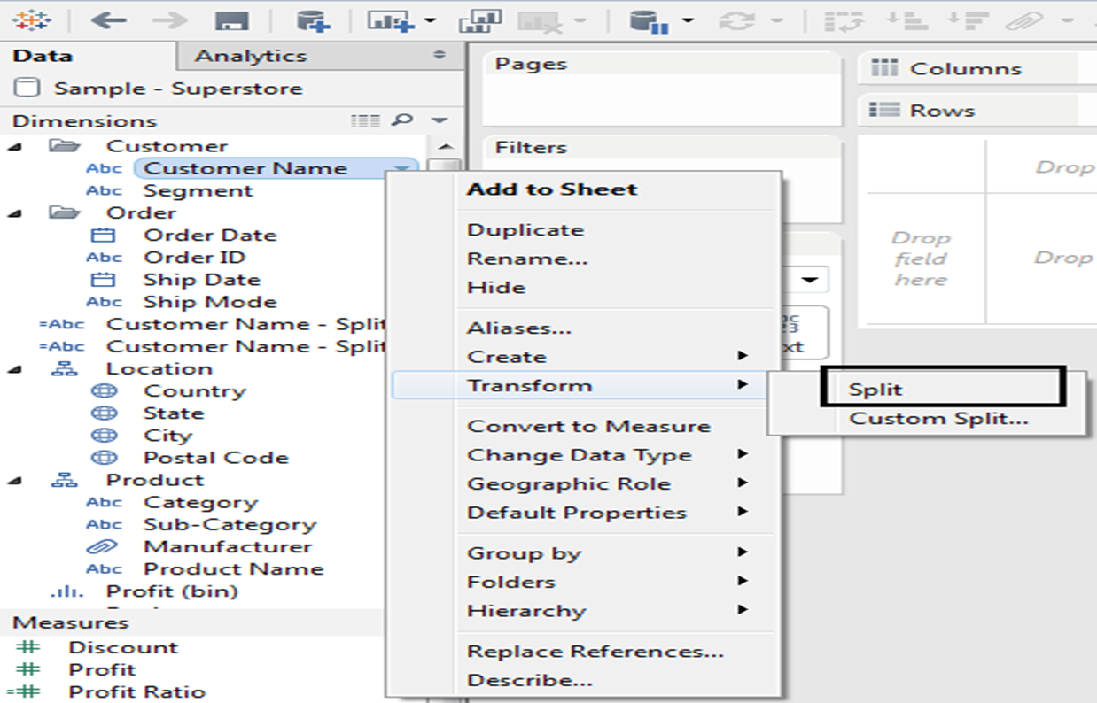
Splitting Data Columns

Slide 7
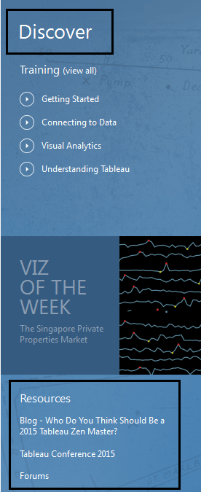
Tableau Discover Side Menu
When you open Tableau v9 for the first time you’ll now notice a new menu on the right that alerts you to a bunch of handy Tableau resources, including links to training for beginners , resources ( blogs ) etc.

Slide 8
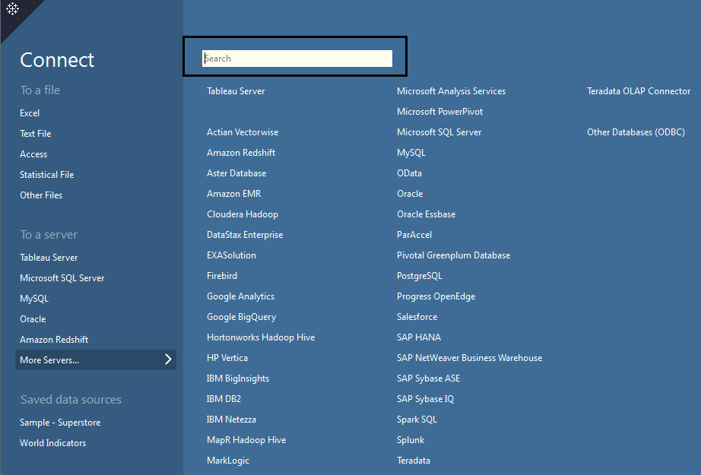
Connecting to Data Source
The search option now gives drop-down menu, which allows you to really quickly connect to a new data source,
without having to navigate to another page.

Slide 9
Tool Tip Which is Lightening Fast
In current versions of Tableau, a tooltip only stays alive for 8 seconds and then it disappears.
Now in Tableau v9, tooltips stick around for as long as you leave your mouse in place.
Furthermore, tooltips are now super responsive, populating with new data for whichever mark you’re hovering over in real-time. You can disable it as well using tooltip window

Slide 10
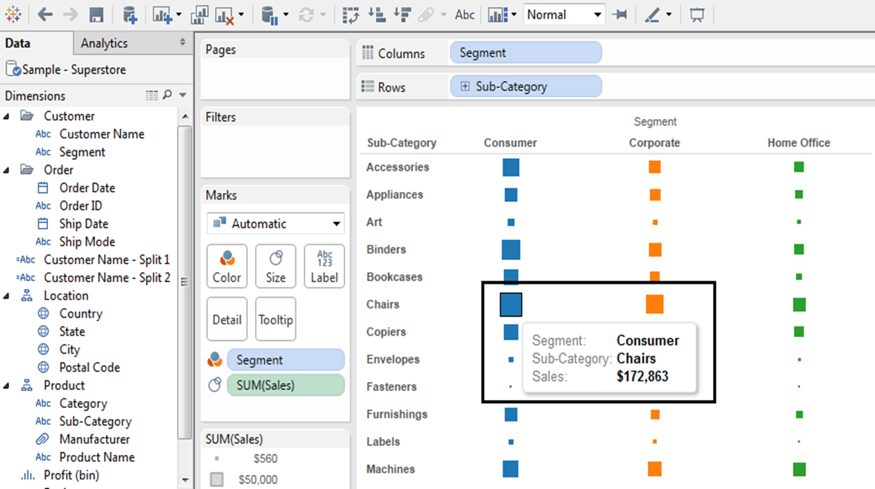
Tool Tip Which is Lightening Fast

Slide 11
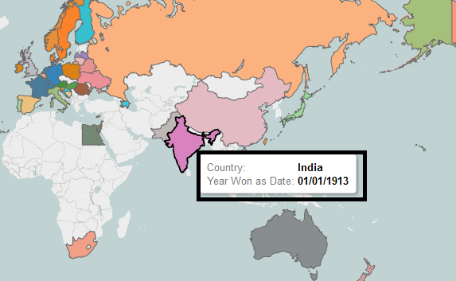
Responsive Tool Tips
Responsive Tool Tip is the new feature in Tableau 9.0
Let’s check What Responsive tool tips are.
While hovering on the visualization. We can view this tool tips which provides complete details about the Visualization at that particular point.

Slide 12
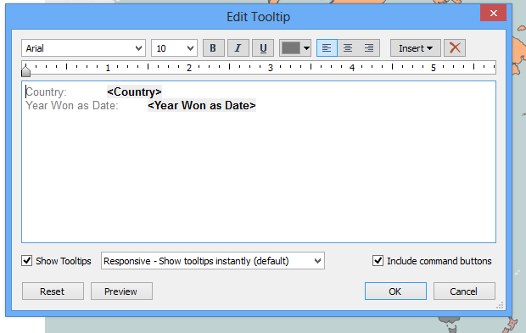
Responsive Tool Tips
If we are not comfortable with this Responsive Tool Tips we can change it by clicking on the tooltip
We can change the Responsive tool tip to On hover Tool tip which is an old version feature. And we can change the content present in the tool tip with different formatting tools.
If tool tip is uncomfortable we can unpick show tooltip.

Slide 13
Data Interpretation
Tableau 9.0 is built in with Data Interpretation option. What is Data Interpretation.
Data Interpretation:
Data Interpretation is the process of making sense of numerical Data that has been collected, analyzed and Presented.
Let’s check how to use Data Interpretation in Tableau.

Slide 14
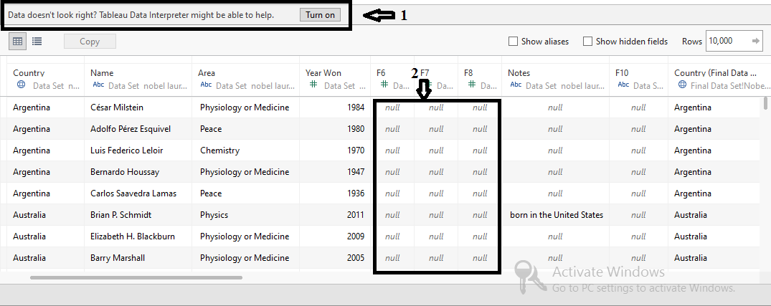
Data Interpretation
Point 1 is showing some message that Tableau going to tell us. “Data doesn’t look right? Tableau Data Interpreter might be able to help”.
Why our data is not looking right? Let’s check Point 2, Some rows are showing data as null. Does it add any sense if we import a improper data.
Very difficult to check the data one by one step by step. So Tableau tells us data is not right, if there is any improper data.

Slide 15
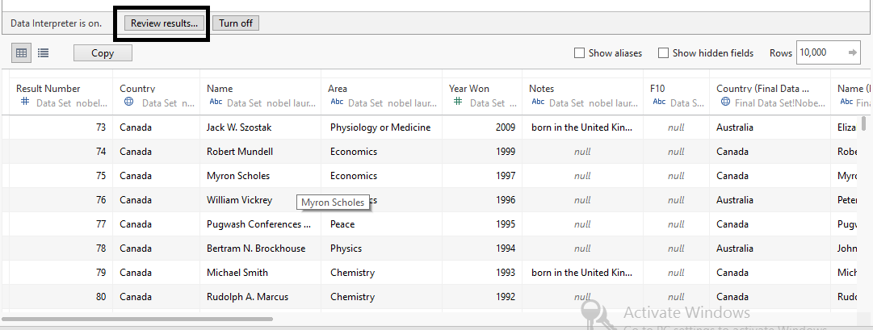
Data Interpretation
Click on Turn on Button.
Below screenshot shows data after Data Interpreter is on. I want to know the changes what Data Interpreter has done to my data.
For that please click on Review results button.

Slide 16
Data Interpretation
By clicking on the Review Results button. We will be redirected to an Excel Sheet.
In key points Tableau clearly mentioned what Data Interpreter has done to our data.
Check the screenshot in next slide, Now all the data is arranged same as the data present in our source data.

Slide 17
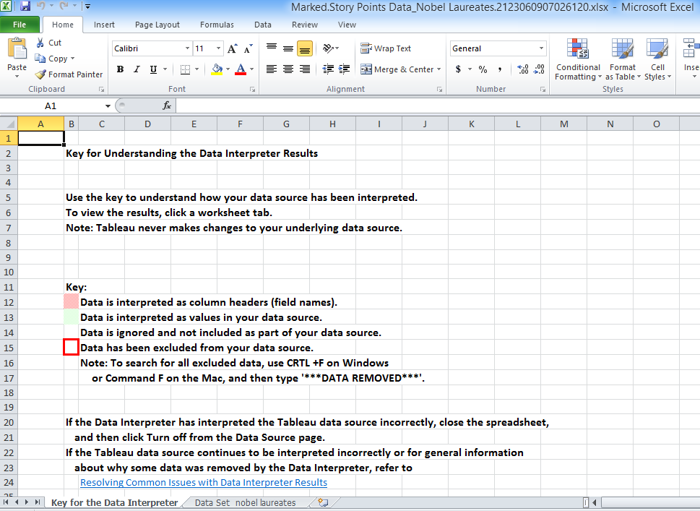
Data Interpretation

Slide 18
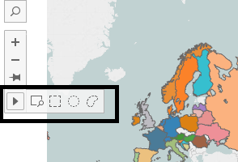
Radial & Lasso Selection
Radial and Lasso Selection are the new features in the Tableau
While we hovering towards the left corner we can find this icons. Last icon which is highlighted is used for the purpose of filtering selected area.
Last two icons in the Filtering icon are called as Radial and Lasso Selection icons.

Slide 19
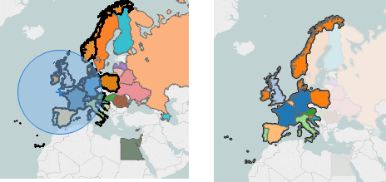
Radial & Lasso Selection
Radial Selection:

Slide 20
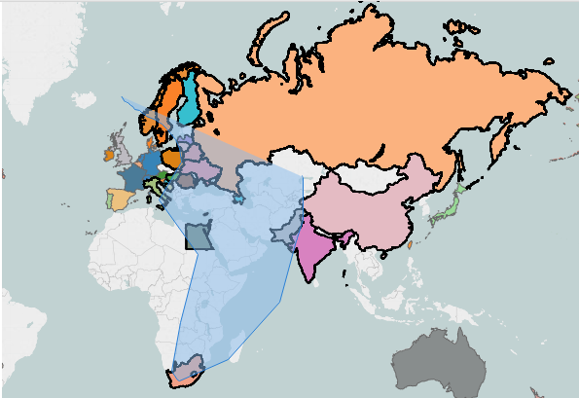
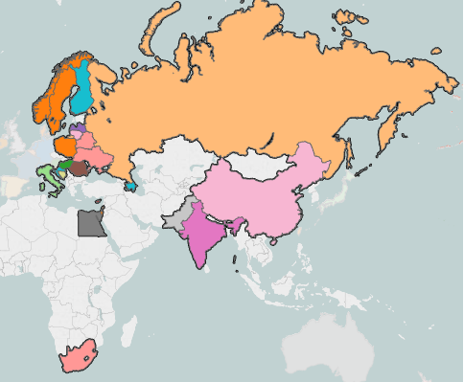
Radial & Lasso Selection
Lasso Selection:

Slide 21
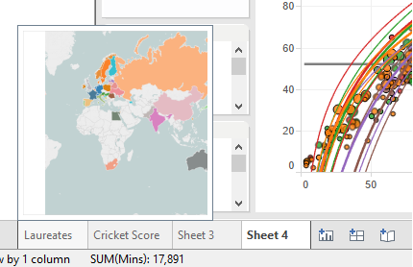
Thumbnails Pop-Up
While we hover on Sheets or Dashboards or Story, Thumbnails will be pop-up.

Slide 22
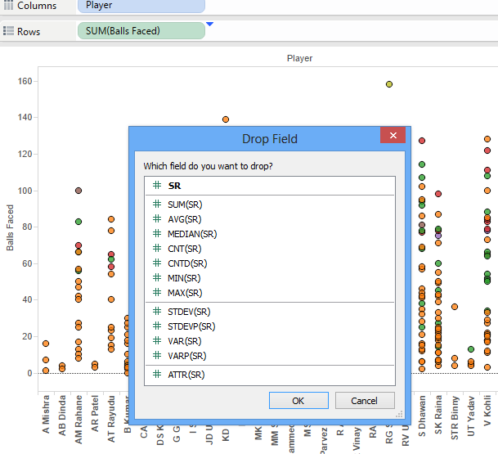
Right Click Filtering
By dragging the fields with Right Click we can filter the fields while dropping.
Let’s check how it works.

Slide 23
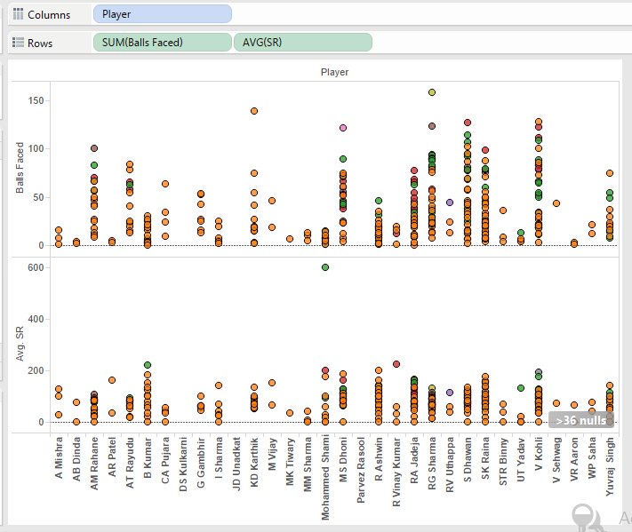
Right Click Filtering
After dropping the SR field in the rows, a pop up comes with message “Which field do you want to drop ?”
We need to select the field which is to be dropped.
I have selected the Avg. SR and we can see Avg. SR in the rows.

